Slide 1

Machine Learning Based model to predict Connectel Customer Churn Behavior
Presented by Kaothar Adedeji

Slide 2
Introduction
ConnectTel is a leading telecommunications company at the forefront of innovation and connectivity solutions. With a strong presence in the global market, ConnectTel has established itself as a trusted provider of reliable voice, data, and Internet services. Offering a comprehensive range of telecommunications solutions, including mobile networks , broadband connections, and enterprise solutions.
ConnectTel Telecom Company has faced the pressing need to address customer churn, which poses a significant threat to its business sustainability and growth.

Slide 3
Problem Statement and Objectives
The problem statement for this predictive project is to develop a robust customer churn prediction system for ConnectTel.
The objective is to accurately forecast which customers are likely to churn (i.e. discontinue their services) based on historical customer data.
Hence, by leveraging advanced analytics and machine learning techniques on the provided dataset, and providing recommendations to the company, the aims is to implement targeted retention initiatives to reduce customer attrition, enhance customer loyalty, and maintain a competitive edge in the telecommunications industry.

Slide 4
Methodology
Data Overview and Exploratory data analysis (EDA)
Supervised Machine Learning , a classification analysis
Preparing and processing Data for Modelling, Variable encoding ,Missing data handling, Data Segmentation , Scaling and data normalization
Model Building ,Training and prediction ( Naïve Bayes Classifier, Random Forest classifier, Xgboost Classifier and Support Vector Model Classifier
Model Evaluation metrics ( Classification report and Confusion matrix)
Model Optimization/ Hyperparameter and Feature Importance

Slide 5
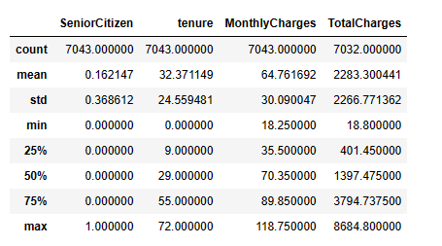
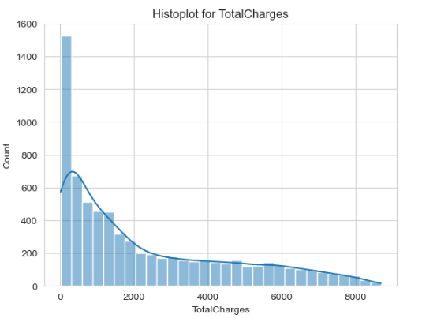
Statistical Description

Slide 8
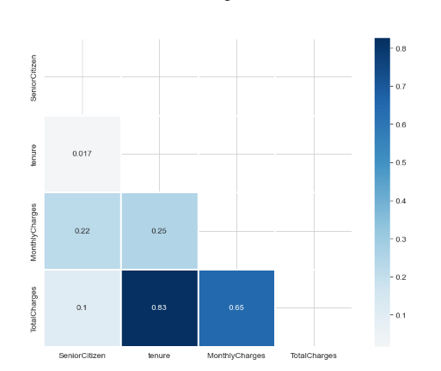
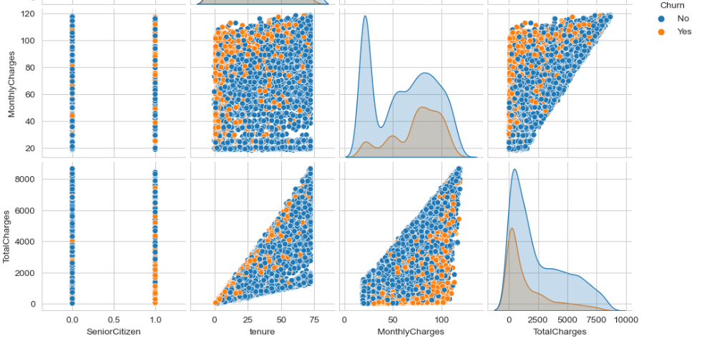
Correlations among numerical features

Slide 9
A robust correlation of 0.83 is noted between tenure and total charges indicating a strong relationship
Similarly, monthly charges and total charges demonstrate a correlation of 0.65 suggesting a moderately strong relationship
In contrast the remaining features exhibit weak correlations with each other
In the multivariate analysis hued by churn behavior.
Typically, a small number of customers churn as a result of high monthly charges
At low tenure range and high monthly charges , a clustered customer churn behavior is exhibited

Slide 10
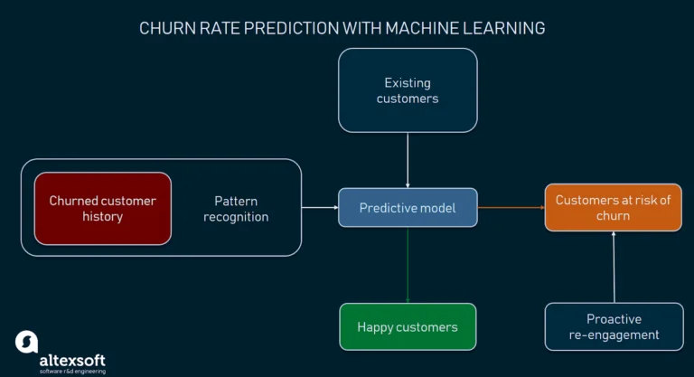
Machine Learning Model
A supervised type of machine learning algorithm is applied to a classification analysis
The algorithm is trained on 70% labelled data and tested on 30% data
The goal is to learn a mapping function to predict the target variable for new unseen data accurately
The various algorithm used involve Naïve Bayes , Random forest , support vector machine and Xgboost classifier

Slide 11
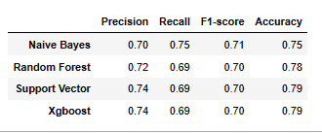
Evaluation Metrics
Classification report and Confusion matrix are used
The performance of these 2 models is also evidenced by the confusion matrix
Support Vector model TP = 67.11% and FN = 14.41
Xgboost TP = 63.18% and FN = 12.75%

Slide 12
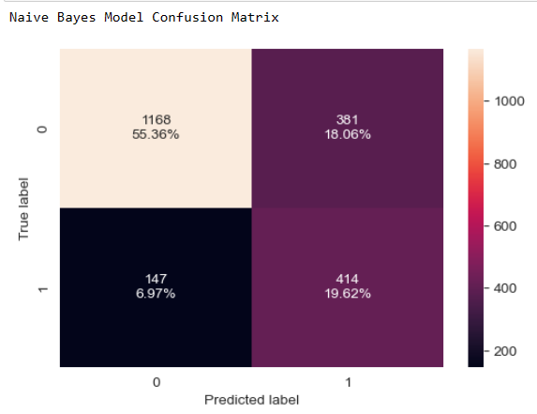
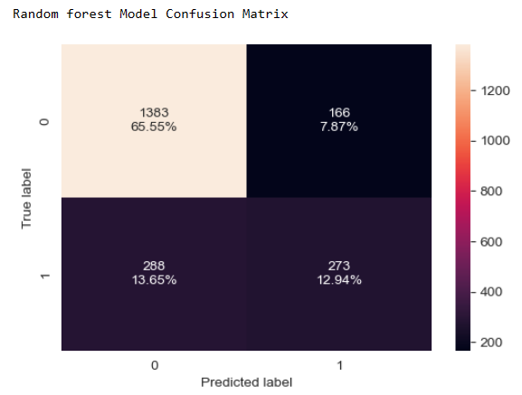
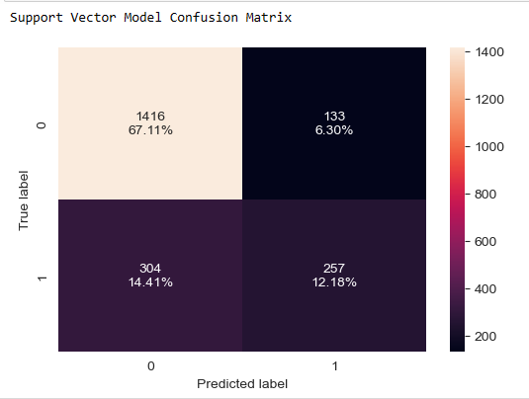
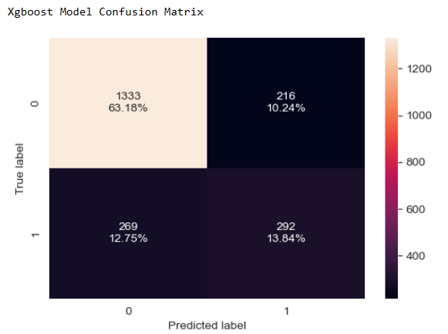

Slide 13
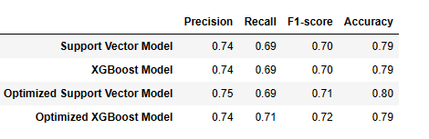
Model Optimization
Evaluating using the confusion metric,
SVM : TP = 66.13 and FN = 12.61
Xgboost : TP = 65.45 and FN = 12.61
Differences in the value of TP and FN:
SVM : TP (67.11 – 66.13 = 0.98%) , FN (14.41 -13.93 = 0.48%)
Xgboost: TP (65.45 – 63.18 = 2.27%) ,FN (12.75 – 12.61 = 0.14%)

Slide 14
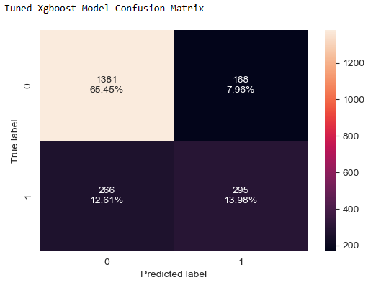
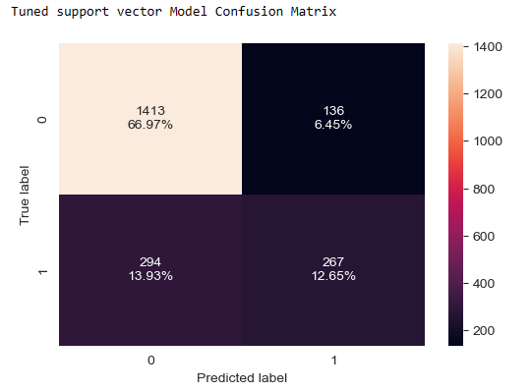
Most Improved Models

Slide 15
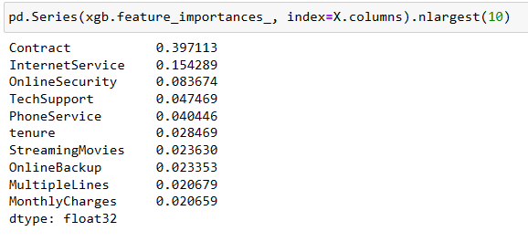
Feature Importance

Slide 16
How Frequent should the model be Updated?
If there is a steady influx of new data, updating the model more frequently can help incorporate the latest trends and patterns
Monitor the model’s performance over time. If there is a noticeable decline in accuracy or predictive power. It may be time to update the model
The update frequency should be aligned with the company’s goals and decision making cycles
Incorporate feedback loops to gather insights from model users, stakeholders or domain experts. Their input can inform the need for model updates and improvements

Slide 17
Limitation
While the model is highly accurate , it’s essential to acknowledge potential limitation and bias
There are 11 missing values in the total charges, which were addressed by deleting the entire rows containing missing values
The choice made in handling the missing values depends on the extent of missingness

Slide 18
Conclusion
Utilizing an analytical approach, insights extracted from this analysis revealed the following:
Factors such as contract type, lack of tech support, absence of internet support, reliance solely on phone service, lack of online security measures, specific internet services, and payment methods significantly influence customer churn behavior.
Furthermore, in the multivariate analysis of numerical values A robust correlation of 0.83 is noted between tenure and total charges indicating a strong relationship
Xgboost model demonstrate a high F1 score of (0. 72%) in predicting churn based on my validation tests
The model built will be used on a new dataset to accurately forecast which customers are likely to churn

Slide 19
Recommendations
Based on the model’s predictions , I suggest:
Invest in improving tech support services to address customer queries and concerns more efficiently.
Increase availability and reliability of internet support services to ensure customers have consistent access to assistance and troubleshooting.
Implement robust online security measures to protect customer data and privacy, reassuring them of the safety of their online interactions and transactions.
Highlight the benefits and advantages of specific internet services to attract and retain customers seeking high-speed, reliable connectivity.
Offer a wider range of payment methods to accommodate diverse customer preferences most especially the non automated payment method, making it easier for customers to manage their accounts and reduce churn.
Consider revising pricing structures to ensure they align with customer expectations and budget constraints, potentially offering more flexible options or discounts to mitigate the impact of rising monthly charges on churn behavior

Slide 20

Thank you

